Slide 1
BIRTH RATE ANALYSIS OF TEENS OF AGE 15-19 YEARS OF U.S.

Slide 2
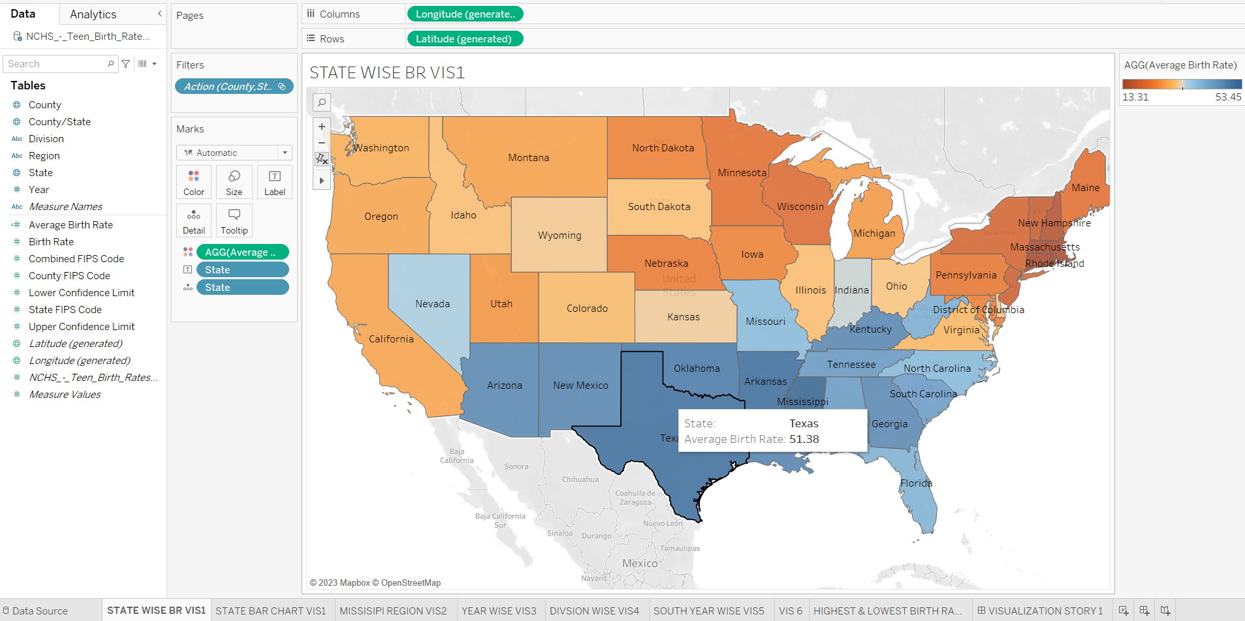
Visualization 1

Slide 3
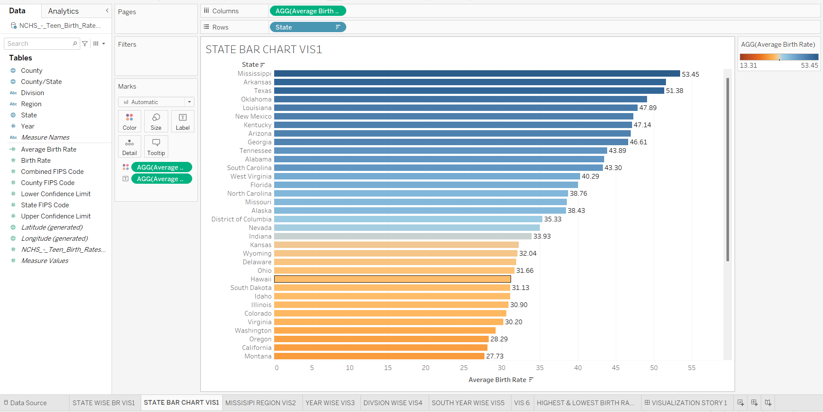
Visualization 1

Slide 4
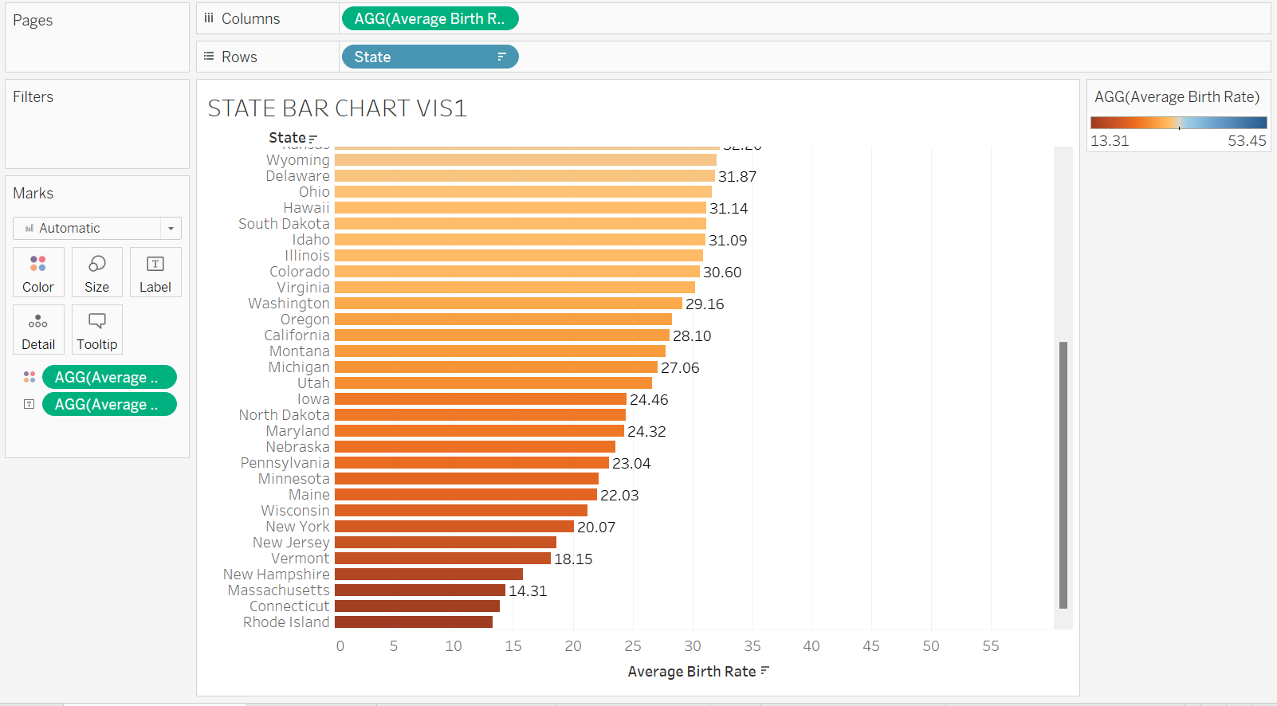
Visualization 1

Slide 5
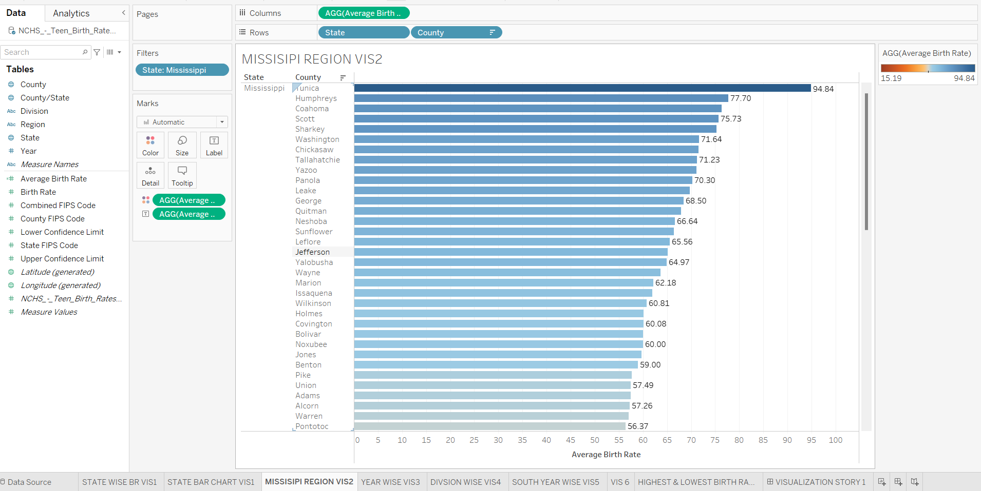
Visualization 2

Slide 6
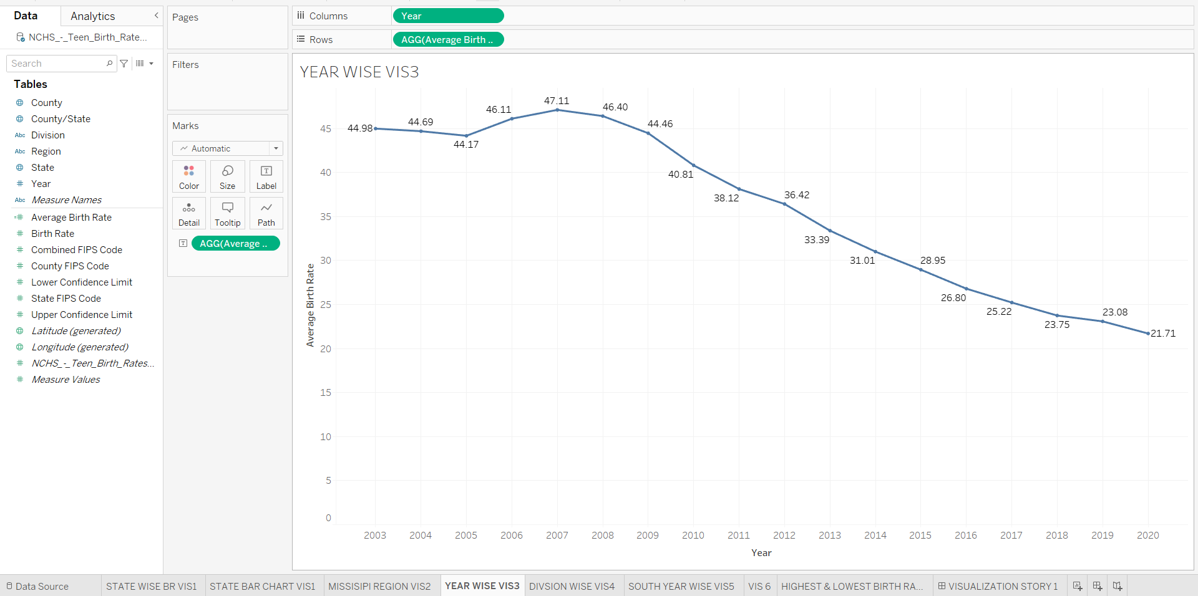
Visualization 3

Slide 7
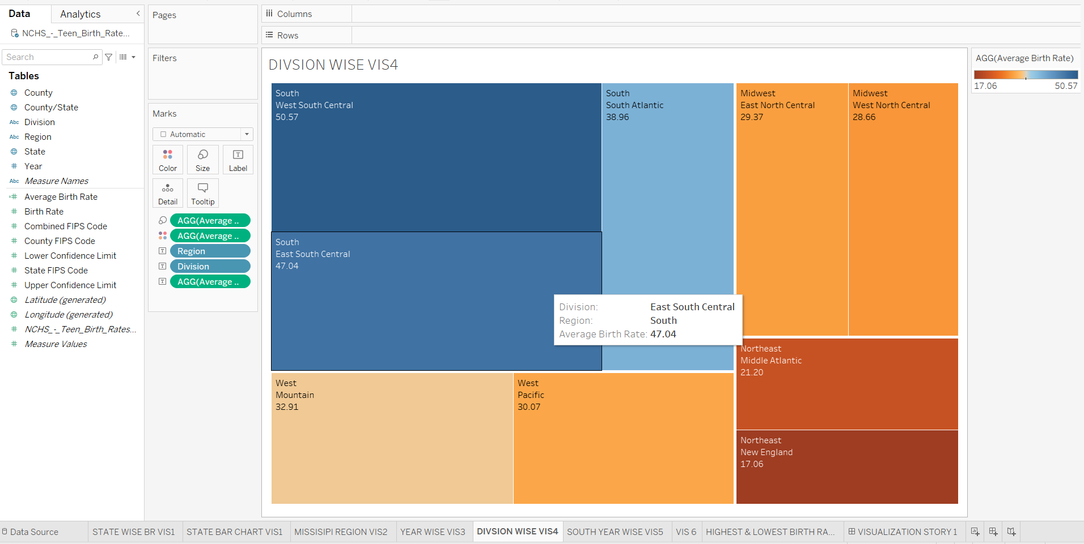
Visualization 4

Slide 8
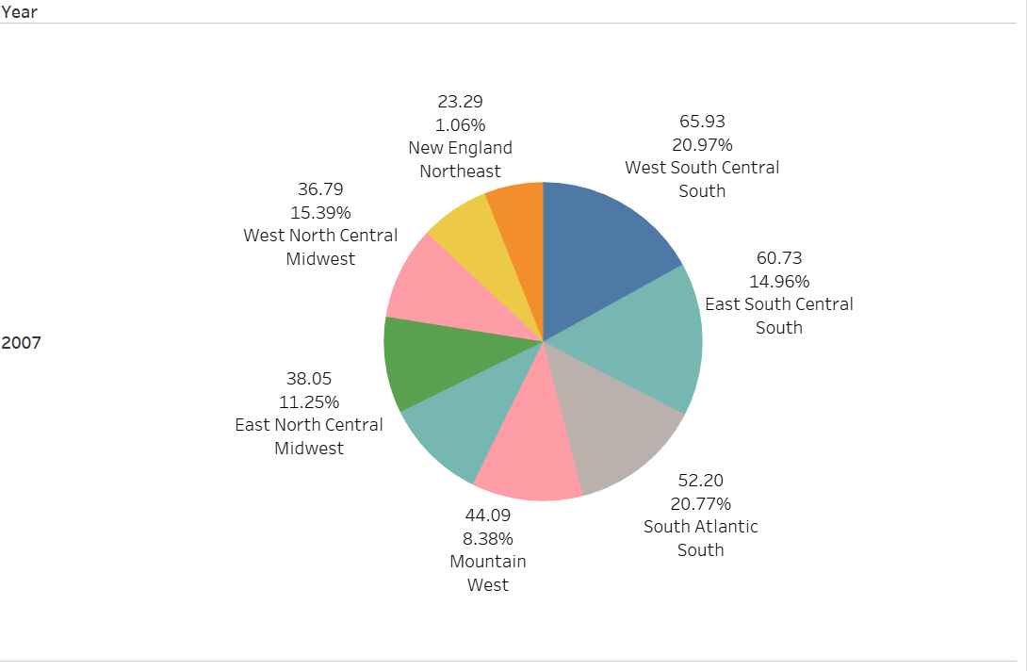
Visualization 5

Slide 9
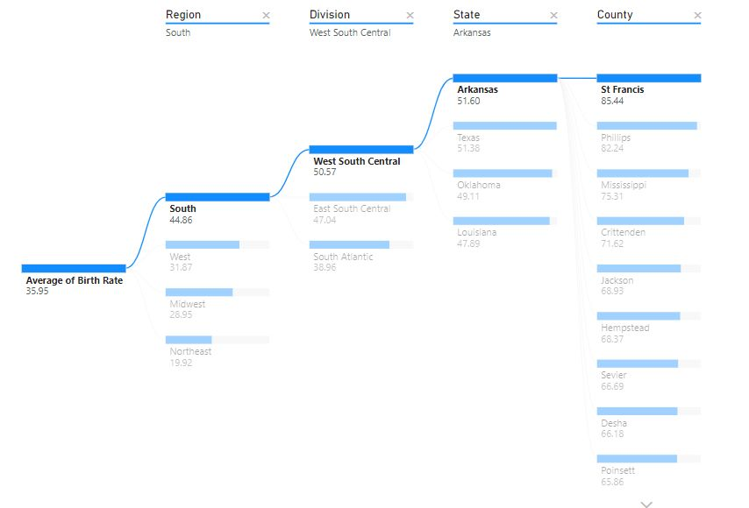
Visualization 6

Slide 10
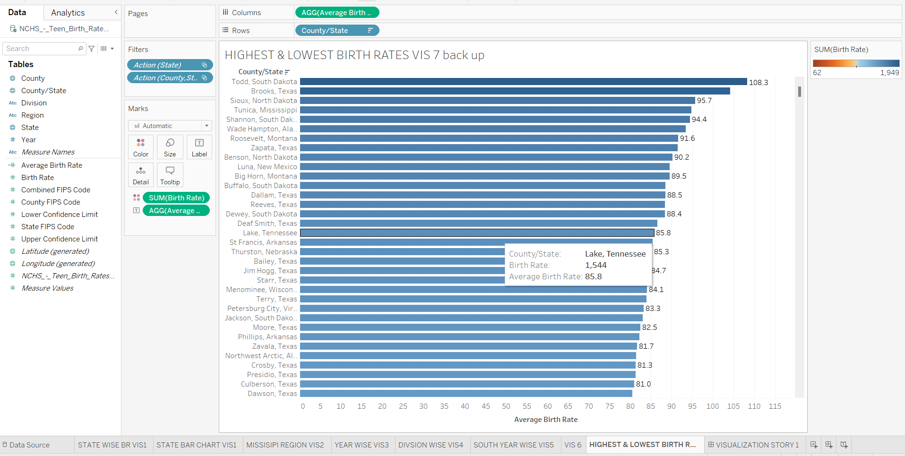
Visualization 7

Slide 11
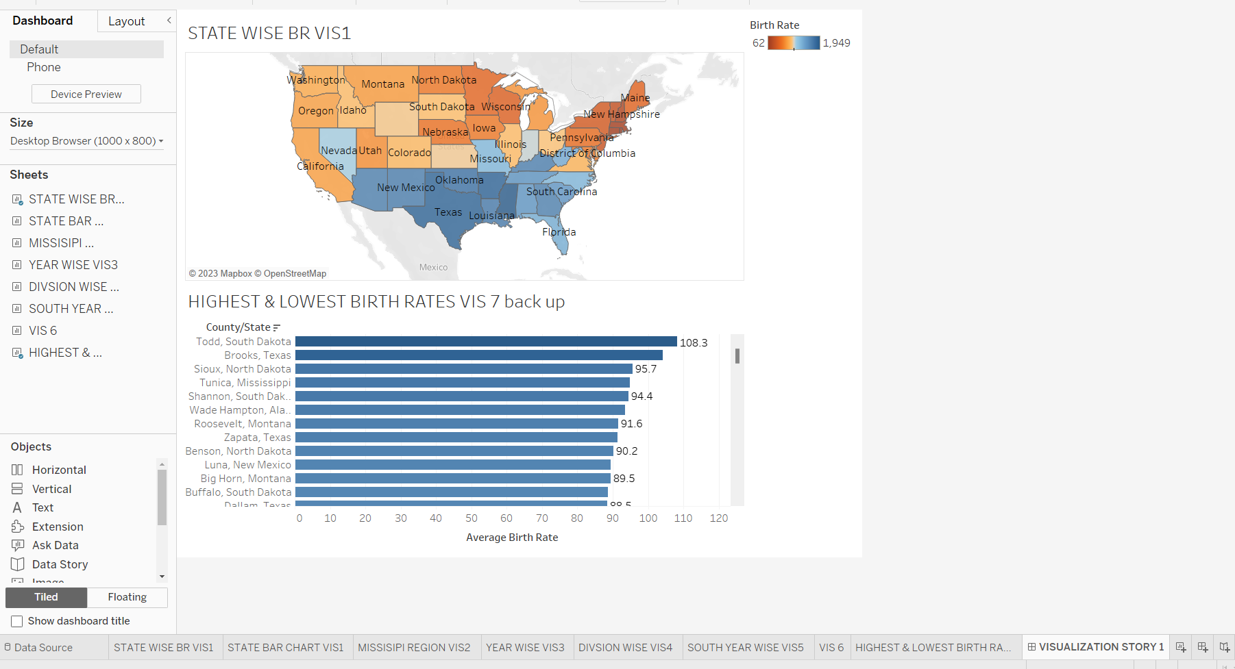
Visualization 7

Slide 12
THANK YOU
DONE BY : SIDDH BALDHA J005
NAITIK JAIN J031
RUDRA JOSHI J037
ATHARVA NILAWAR J048

